Slide 1
2022
CSYE 7200
Game Recommendation System
---------- Group 2 -----------
Chen Ye - 002951477
Xinzhuo Liu - 002197134
Jingru Xiang - 001586653

Slide 2
Catalog
01
05
02
Introduction
06
Goals
03
05
Mile Stones
04
Acceptance Criteria
Methodology
Data Source
User cases

Slide 3

Introduction
Game Recommendation System
- Basis for the selection: Steam is a world-renowned game platform. Therefore, there are many data sets collected and sorted by data enthusiasts related to it on the network, which provides us with a very good foundation.
- Project Content: Training data model; the system implement static and dynamic game recommendation tasks.

Slide 4
Mile Stones
Mar. 27th – Apr. 5th
Apr. 6th – Apr. 13th
Apr.13th – Apr.20th
Apr.20th – Apr.27th
Apr.27th – Apr. 28th
Collect Data
Preparation
Build Environment
& Data Preprocess
UI & Train and Test
Model & Backend
Presentation
Collecting data from Kaggle, deciding complete logic and technology we need, preparing for planning presentation(All)
Comfirming steps for data processing, assigning jobs (Jingru Xiang). Deploying the Play framework (Xinzhuo Liu). Doing some work to clean data (Chen Ye).
Importing all packages needed by sbt. Confirming the model. Preprocessing data to fit the model (Jingru Xiang).
Finish UI with Swagger UI (Chen Ye). Train model, using mathematics method to validate model, and providing the method for backend to update dataset (Jingru Xiang). Connecting MongoDB in backend and finishing controller and model parts (Xinzhuo Liu).
PowerPoint and prepare for presentation(All)

Slide 5

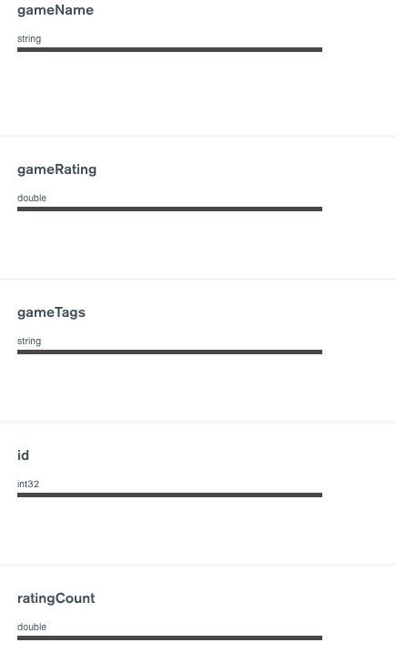
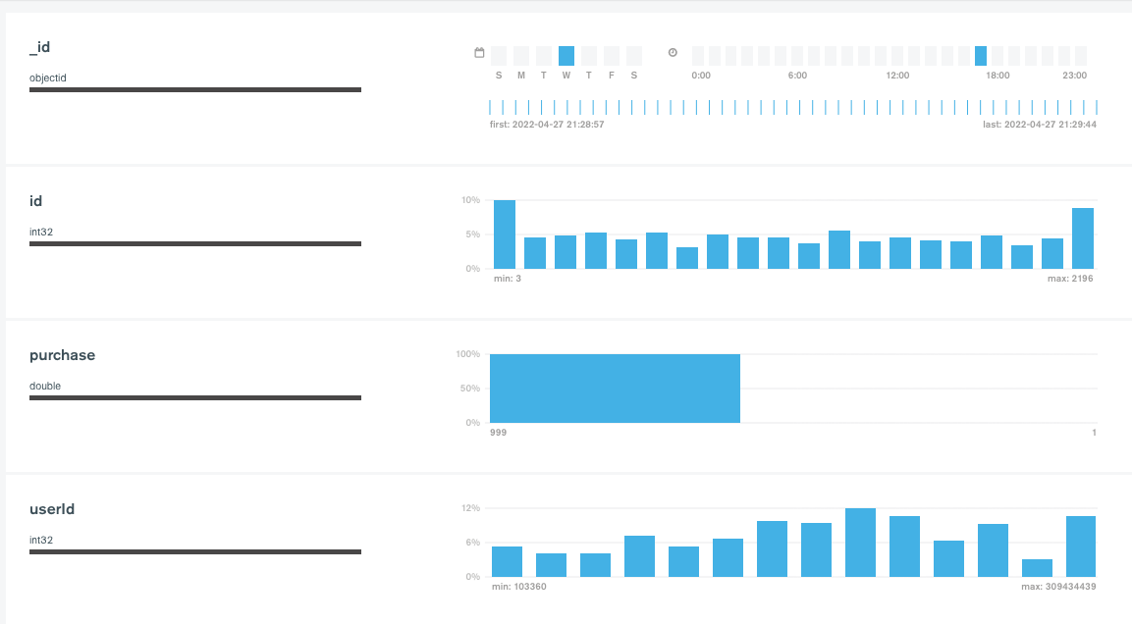
Data Source
User portrait database (200k)
https://www.kaggle.com/code/danieloehm/steam-game-recommendations/data
steam game database (2.7k)
https://www.kaggle.com/datasets/nikdavis/steam-store-games

Slide 6
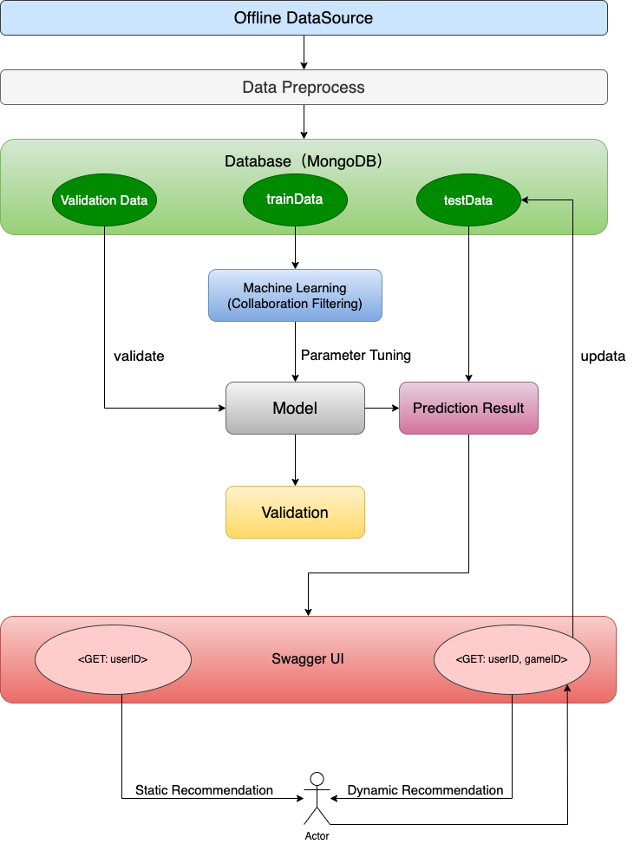
User cases
- Data Preprocess:
User Data — Train (15.6m), Validation (4.4m), Test (2.2m)
Game Data — Game (2.2k)
- Machine Learning: ALS Algorithms (Collaborative Filtering)
- System Design:
Registered User Login —> Get User ID —> Recommendation (Static)
New User/ Registered User Search —> Get User ID & Game Name —> Model —> Recommendation (Dynamic)

Slide 7

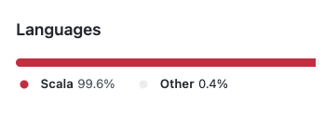
Methodology
For ML: Alternating Least Square Algorithms (Collaborative Filtering)
Using similarities between users and items simultaneously to provide recommendations.
Matrix factorization models are superior to classic nearest-neighbor techniques for producing product recommendations, allowing the incorporation of additional information such as implicit feedback, temporal effects, and confidence levels
Easy to use: ALS Algorithms is in spark.mllib package
For Data R/W: MongoDB & Spark & Mongo-Spark-Connector
For System: Play Framework & Swagger & ReactiveMongo
Using ReactiveMongo API to connect project with MongoDB
Connecting to Swagger-UI with annotations
(99.6% Scala)

Slide 8


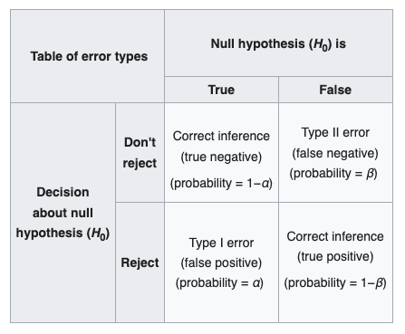
Acceptance criteria
Content
The average correlation between the game and the user‘s preference on the recommended user page is more than 70% (Mean Square Error: 99.8%)
Confidence level:
Recommended & Interested: Recommended & Not interested = 1:1
True & Don't reject + False & Reject = 99.8%
Users
1. The user gets the results of the initial login referral page for less than 1s
2. The user gets an update page refresh for no more than 1s
System
1. The user's initial data is selected and stored by the database(Distinct user in 30% data in user portrait database)
2. User search tags are logged in the MongoDB database

Slide 9
Goals – Satisfied and Not
Trained an efficient recommendation model
Captured user action and give valid and timely recommendations
Succeed to build our all system and finished complete progress from data clean to recommendation
Improve search speed:
When we tried to search certain User ID in 2.2 million data, the response time may last several seconds
How to solve:
Searched and cached the user data when user login in
To be
improved
Satisfied
The Goals

Slide 10
2022
CSYE 7200
Thank you
& Demo Time
END

